Slide 1
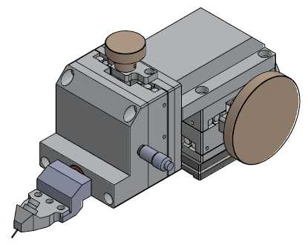
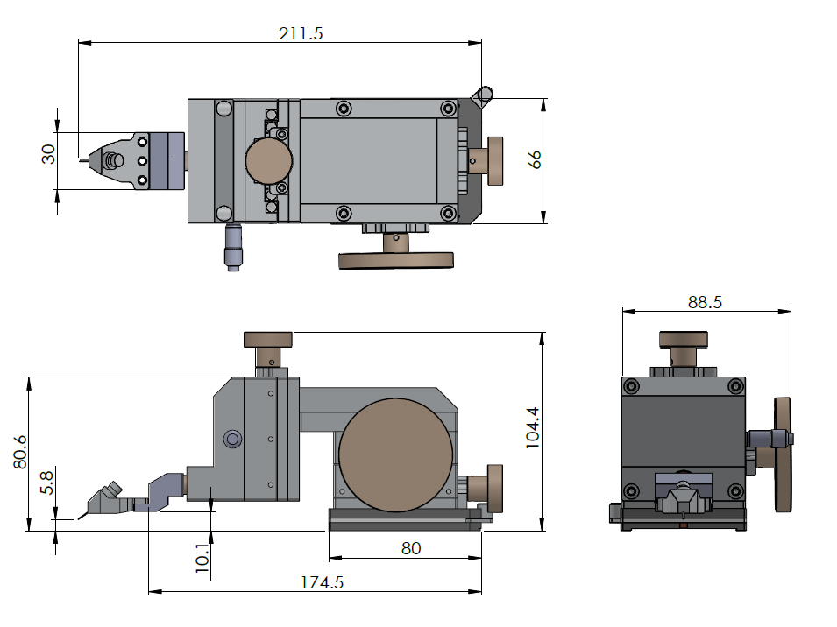
RF Probe Positioner – Version 400
DATA SHEET
HPS-PST30-400
The PST30-400 is an stable and extremely precise RF probe positioner built for research R&D and university lab probing use.
The of probe positioner is specifically designed to address the requirements of research personnel - simplicity and ease
SPECIFICATIONS
Dimensions 88.5mm X 104.4 mm X211.5mm (3.5” X 4.1” X 8.3”) (W,H,L)
Weight 2.4 kg (5.2 lbs.)
Base Magnetic base or Vacuum base with on/off switch
X-Y-Z Movement Fine micrometer adjustment – 30 mm (X, Y, Z) Min scale is 10um
Z axis prevent sliding
Theta Movement Travel: 10 degrees (fine)
Material Aluminum electroless nickel plating
Options & Accessories Probe Long connecting rod
Anritsu, keysight, R&S, Frequency Multipliers Holder
Note: Data and specifications vary depending on probe system configurations and accessories
www.honestco.com.tw

